Slide 1
Prospects for green hydrogen in the transport sector
Amela Ajanovic
Energy Economics Group
Vienna University of Technology
IEWT, Vienna, 2021

Slide 2
Content
Introduction
Historical developments
Economic and environmental assessment
RES and storage
Conclusion

Slide 3
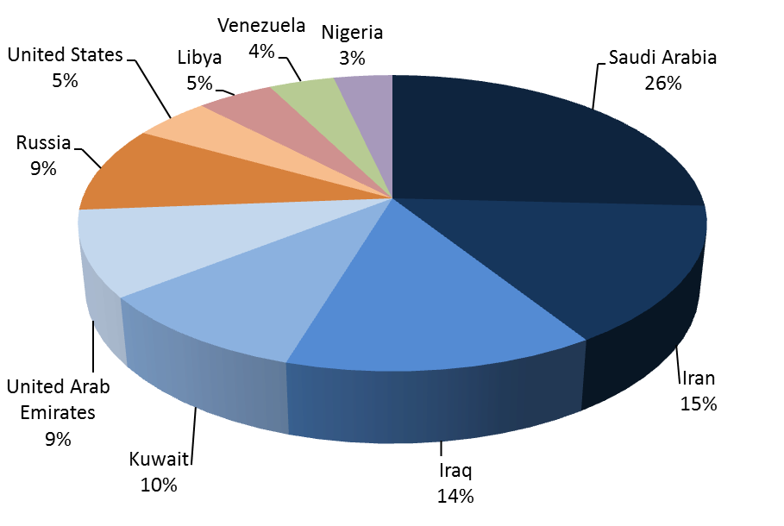
Transport sector
oil products
least-diversified
energy import dependency
Countries with largest conventional oil reserves

Slide 4
Hydrogen
Hydrogen is the simplest, lightest and most abundant element in the universe
high energy density
less flammable than gasoline
non-toxic
hydrogen combustion produces only water
secondary energy carrier …. It can be produced from different energy sources

Slide 5
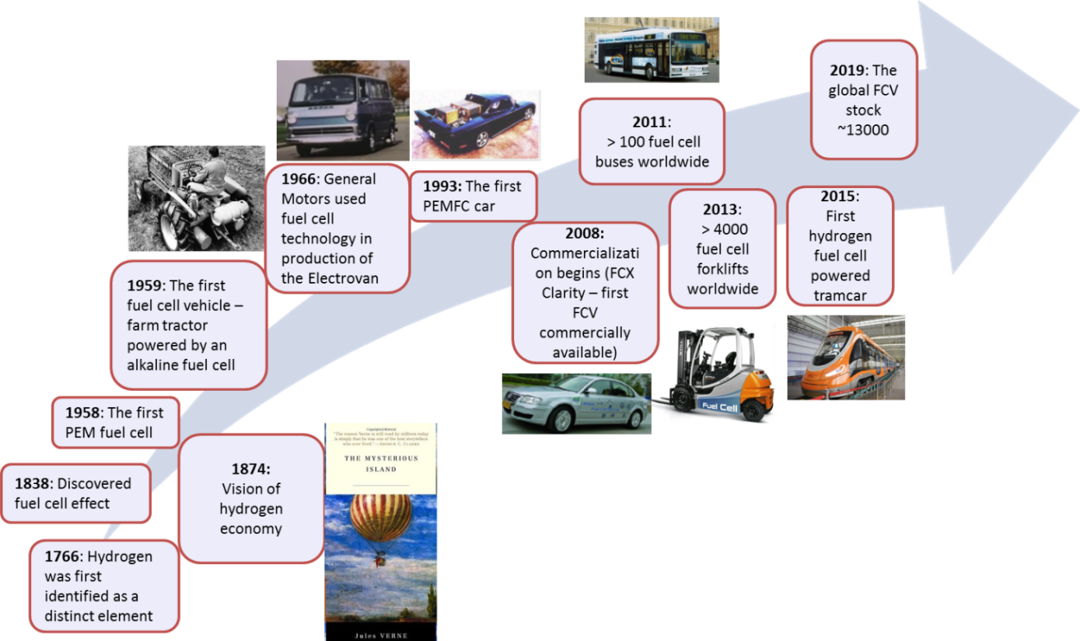

Major historical steps and milestones
in the development of hydrogen and FCV

Slide 6
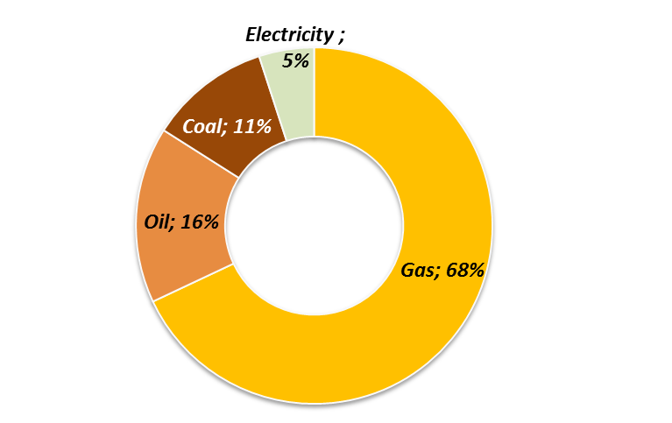
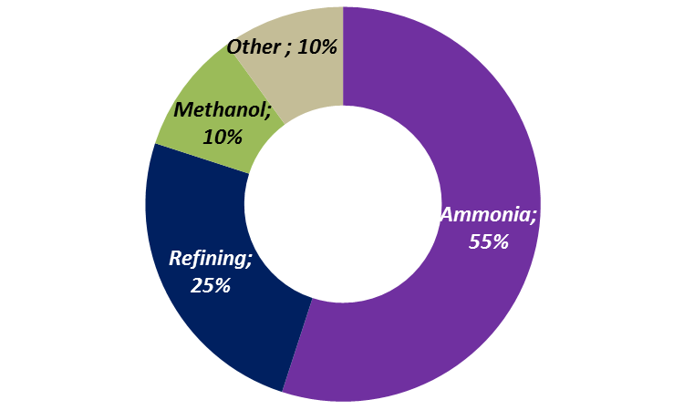
Global hydrogen production and use

Slide 7
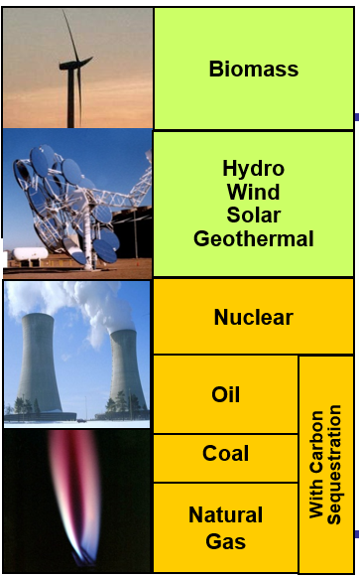

  Colors of hydrogen
Biomass
Hydro
Wind
Solar
Green H2
Oil
Coal
Natural gas
Grey H2
Blue H2

Slide 8
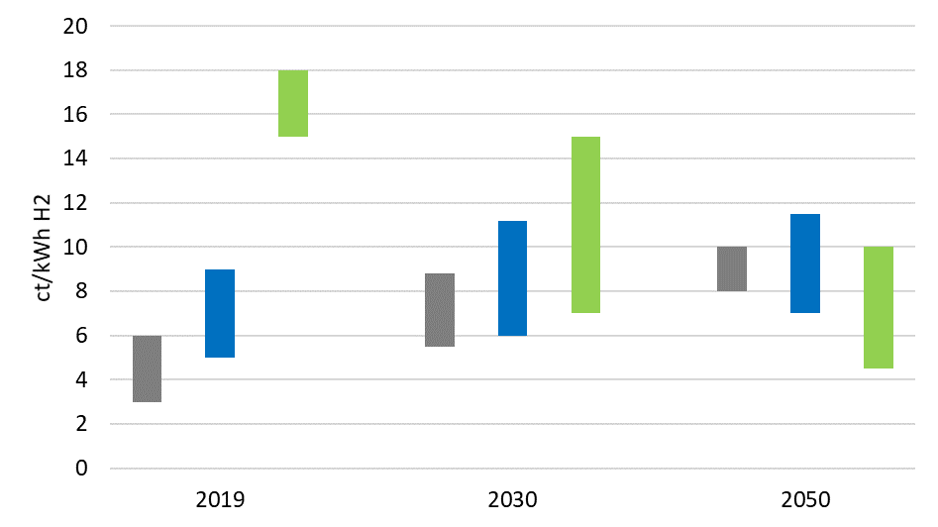
H2 production costs

Slide 9
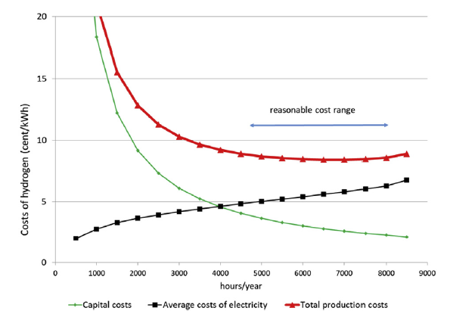

Electrolysis

Slide 10
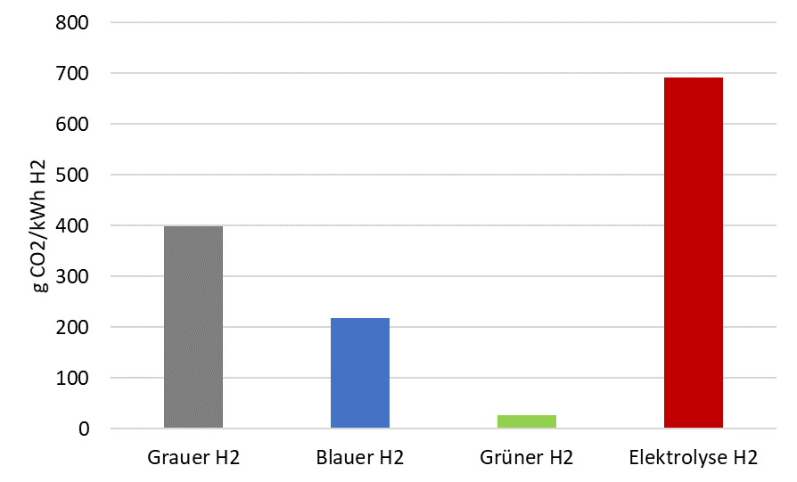
Emissions of hydrogen
Grey H2
Blue H2
Green H2
Electrolysis H2

Slide 11
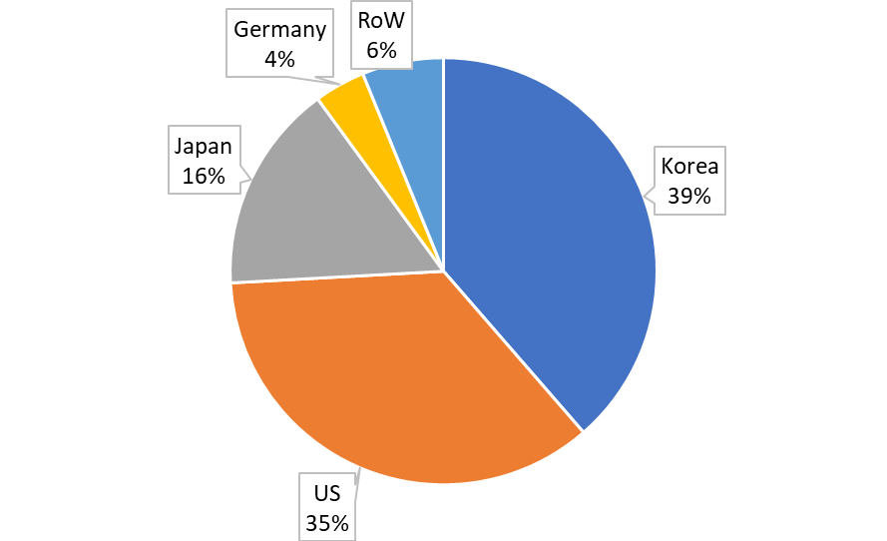
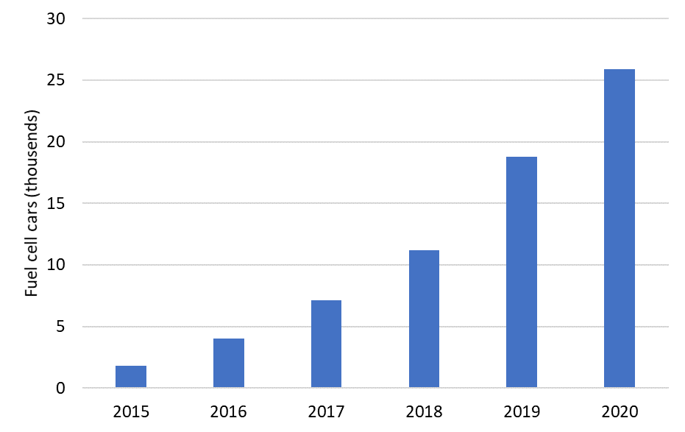
FCV

Slide 12

Economic assessment
The costs per km driven C_{km} are calculated as:
[€/100 km driven]
IC……investment costs [€/car]
α……..capital recovery factor
skm…..specific km driven per car per year [km/(car.yr)]
Pf….….fuel price incl. taxes [€/litre]
C_{O&M}…operating and maintenance costs
FI……..fuel/energy intensity [litre/100 km; kWh/100 km]
A capital recovery factor (α) is the ratio of a constant annuity to the present value of receiving that annuity for a given length of time. Using an interest rate (z), the capital recovery factor is:
n…..the number of annuities received.

Slide 13
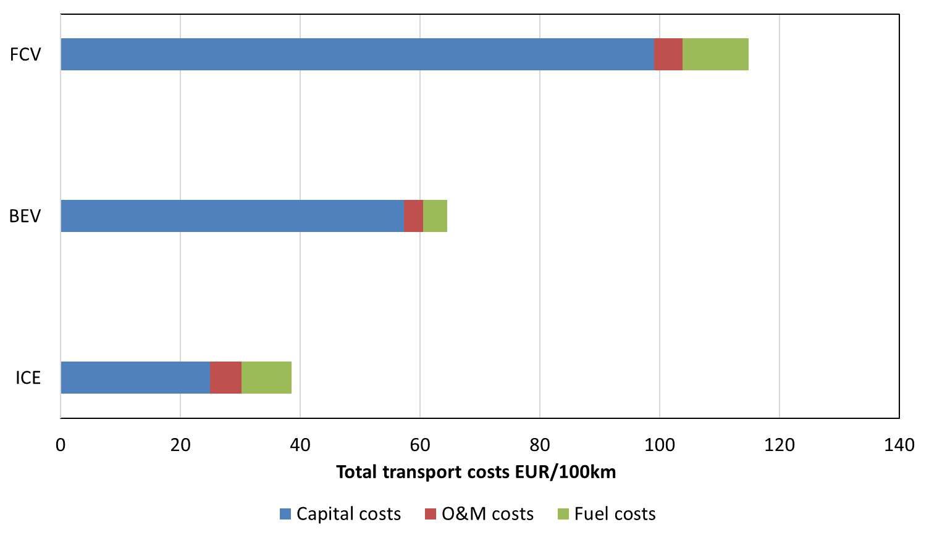
Economic aspects

Slide 14
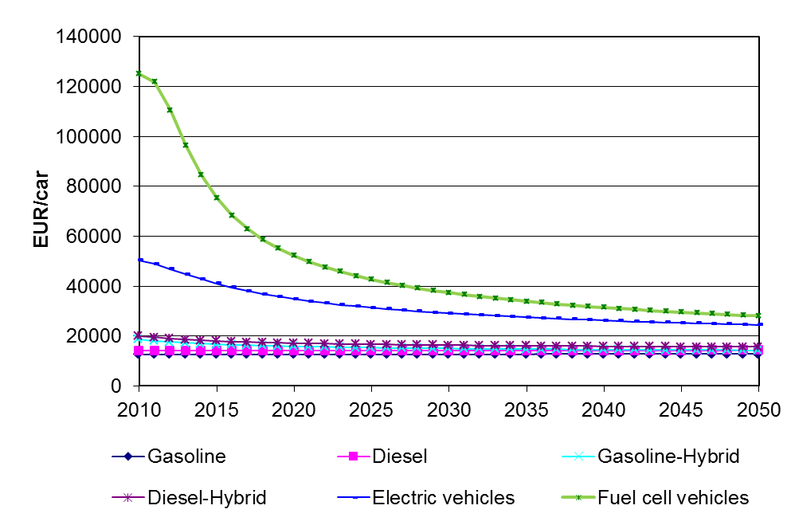
Scenario for development of investment costs
(Power: 80 kW)
FCV
BEV

Slide 15
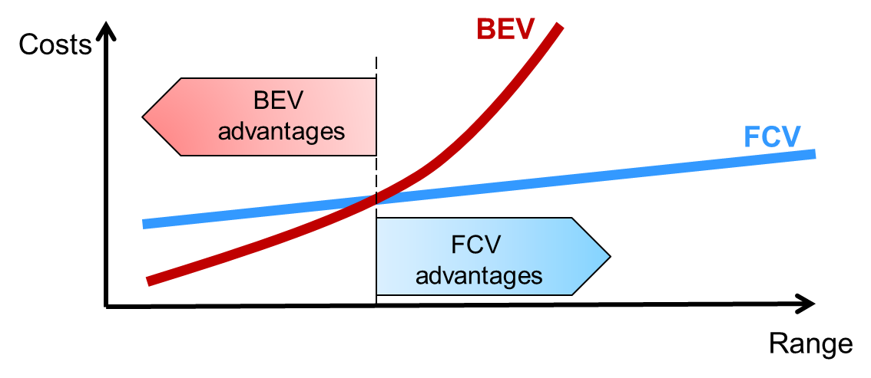
FCVs vs BEVs
Costs
Infrastructure
Fuel efficiency
Refuelling time
Driving range
Weight of energy storage
Environmental benefits

Slide 16

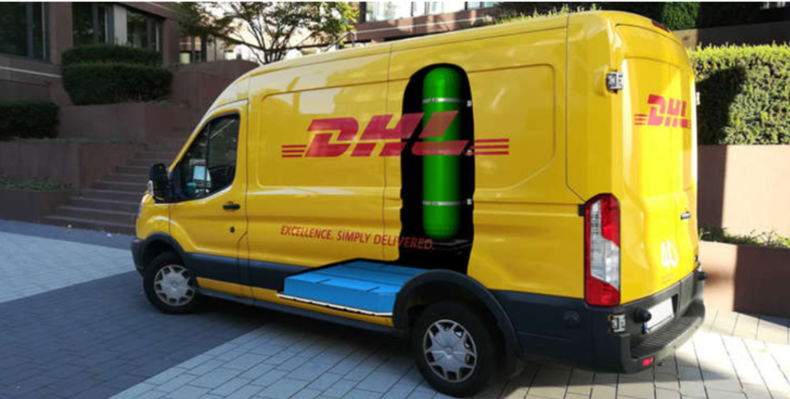




Applications of hydrogen fuel cells

Slide 17
Policy framework

Slide 18
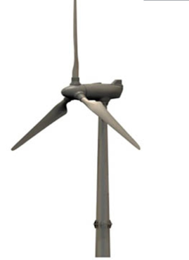


Hydrogen: storage and fuel
η=27-38%
η ≈90%
η=50-60%
η=60-70%
Compressor
Combined cycle
Electricity
H₂
Electricity
Electrolyser
G
H₂
H₂
H₂-Storage
Energy supply chains: Storage and/or use of RES for mobility

Slide 19
Car-oriented mobility
More cars
Congestion
More roads
More cars
More roads
Congestion

Slide 20

Car-oriented mobility
Car-oriented transport development
https://simotron.files.wordpress.com

Slide 21
Towards Sustainable Mobility
Avoid
Shift
Improve
…unnecessary travel and reduce trip distances
….towards more sustainable modes
…transport practices and technologies

Slide 22
Conclusions
…decarbonisation of the transport sector
…integrate more renewables, serving as storage and providing flexibility to grid balance
…enhance energy security
major challenge – cost reduction and infrastructure development

Slide 23
Conclusions
stable policy framework, coordinated action between different stakeholders, standards – to derive economics of scale and reduce risks of the investment
full environmental benefit – green hydrogen
green hydrogen – highest benefits

Slide 24
ajanovic@eeg.tuwien.ac.at

Slide 25
Ajanovic A., Haas R. (2021), Prospects and impediments for hydrogen and fuel cell vehicles in the transport sector, International Journal of Hydrogen Energy, Volume 46, Issue 16, 3 March 2021, Pages 10049-10058, https://doi.org/10.1016/j.ijhydene.2020.03.122
Ajanovic A., Hiesl A., Haas R. (2020), On the role of storage for electricity in smart energy systems, Energy, Volume 200, 1 June 2020, 117473,
https://doi.org/10.1016/j.energy.2020.117473
Ajanovic A., Haas R. (2019). Economic and Environmental Prospects for Battery
Electric- and Fuel Cell Vehicles: A Review, FUEL CELLS 19, 2019, No. 5, 515–529
https://doi.org/10.1002/fuce.201800171

